Slide 1
MIET2565|2566 Systems Engineering Principles Introduction to Systems Engineering – Tutorial – Electrical bicycle

Slide 2
Insert your name, student number and program
Name
Student number
Program

Slide 3
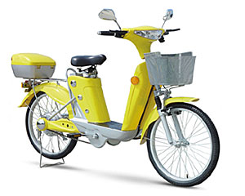
Electric Bicycle

Slide 4
Principles of systems engineering
Systems are created for specified purposes | A form of sustainable transport to allow for quick travel in urban areas
Systems have users | 1 person to ride-on travel
Systems interact with the environment around it
System boundary should be clearly defined
Systems are made by integrating components
Systems are designed by the application of engineering science knowledge
Systems engineering tasks are often not repeating
Systems development and operations are multi-disciplinary

Slide 5
Describe the steps that a user operates this electric bicycle
Release the stand. Hands to hold the handles.

Slide 6
Components used on electric bicycle
Frame
?

