Slide 1
MIET2565|2566 Systems Engineering Principles Introduction to Systems Engineering – Tutorial – Human Jet

Slide 2
Insert your name, student number and program
Name
Student number
Program

Slide 3
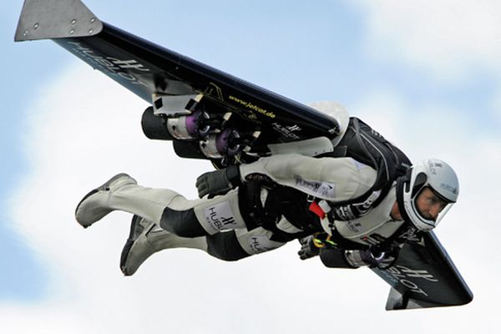
Human Jet

Slide 4
Principles of systems engineering
Systems are created for specified purposes | Fly in jet speed without in an aircraft Intended as a sport
Systems have users | Single person
Systems interact with the environment around it | Flying altitude same as sky dive
System boundary should be clearly defined
Systems are made by integrating components
Systems are designed by the application of engineering science knowledge
Systems engineering tasks are often not repeating
Systems development and operations are multi-disciplinary

Slide 5
Describe the steps that a user operates this human jet
Launch into the air
Land safely

Slide 6
Components used on this human jet system
Wing
Engine
Helmet
?

