Slide 1
MIET2562
Systems Engineering Principles
System Engineering V Lifecycle – Verification Test Plan – Tutorial – Driverless Car

Slide 2
Insert your name, student number and program BEFORE submitting to CANVAS
Name
Student number
Program

Slide 3
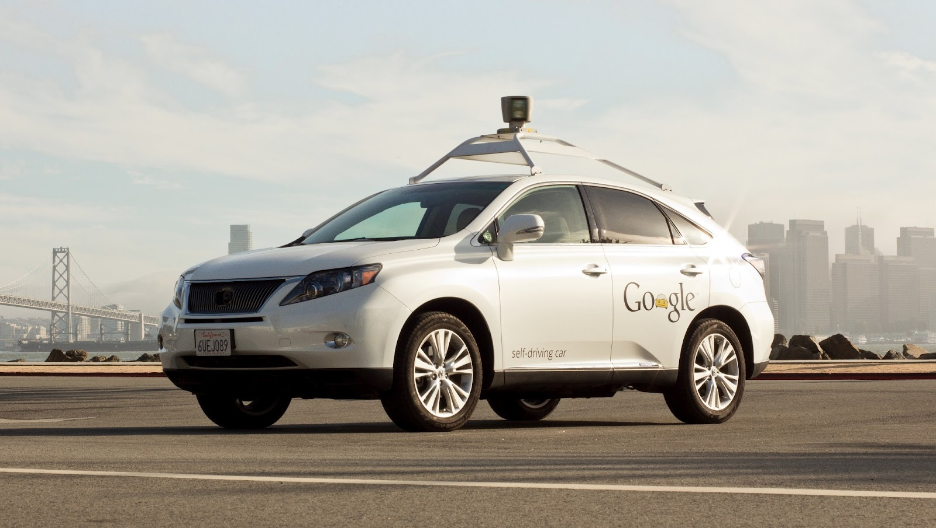
Google Self-driving Car System
https://waymo.com/

Slide 4
Concept of Operations Electric Bicycle
Concept of operations of the system depends on what the user intends to do with the system
Uber style passenger service system
Goods transport service system

Slide 5
Concept of Operations Type B
On a phone Apps, user enters desired destination and number of standard goods boxes, press submit.
The phone Apps sends entered information and user location data to a central server.
The central server commands one driverless van (optimized with routes and capacity) to the user’s location. The driverless van locates the user’s phone location and stops in front of the user.
User opens the van door (side and back) and loads with goods boxes according to loading plan on user’s Apps.
User secures goods boxes with belts on van. Van confirms secured with LEDs.
User closes all doors, steps away.
Driverless van starts journey to next destination.
Driverless van arrives next destination (assume delivery location) and stops at side of road. User opens the van door (side and back), releases belts and unloads goods according to user’s Apps.
After all relevant goods unloaded, user closes all doors and steps away.
Driverless van starts journey to next destination.
User’s phone receives message confirming delivery complete and fees deducted from user’s registered account.
.

Slide 6
Hierarchy of Function – F4 – In-van customer interaction (User Apps interactive instructions)
F4 – In-van customer interaction (User Apps interactive instructions)
F4.1 – Server
F4.2 – Van layout allocation algorithm
F4.3 – In-van cameras
F4.4 – Apps to guide customer loading/ unloading

Slide 7
Hierarchy of Functions – Driverless Car Type B operation
F0 – To transport people without on-board personnel
F2 – In-car customer interaction
(AI conversational)
X
F1 – Server and Apps
X
F3 – Self driving car
F4 – In-van customer interaction (User Apps interactive instructions)
F5 – Self driving van

Slide 8
Type B System FFBD
X
F2 – In-car customer interaction
X
Customer initiated call/order
F3 – Self driving car
F1 – Server and Apps
Debit customer bank account
OR
Goods in van
Goods delivery order
F4 – In-van customer interaction
F5 – Self-driving van
Arrive destination. Goods picked up by customer
Order completed
Driverless Car (Level 0 Function)

Slide 9
F4 – In-van customer interaction
F4.2 – Van layout allocation algorithm
F4.3 – In-van cameras
Goods delivery order
F4.1 – Server
OR
Goods in van
Goods delivery order
AND
4.4 – Apps to guide customer loading/ unloading
Arrive destination. Goods picked up or loaded by customer
Order completed
F4 – In-van customer interaction (User Apps interactive instructions)

Slide 10
Function F4.1 – Server
Customer order goods data
4.1 Server
Layout of goods
Available algorithm

Slide 11
Function F4.2 – Van layout allocation algorithm
F4.2 – Van layout allocation algorithm
Provision of algorithm program

Slide 12
Function F4.3 – In-van cameras
F4.3 – In-van cameras
Activation signal (YES/NO)
Video data stream

Slide 13
Function F4.4 – Apps to guide customer loading/ unloading
Customer order goods data
F4.4 – Apps to guide customer loading/ unloading
Goods delivered / picked up (YES/NO)

Slide 14
Questions?

