Slide 1
MIET2385 Systems Engineering Principles Systems Engineering V Lifecycle – Verification Test Plan – Tutorial – Electrical bicycle

Slide 2
Insert your name, student number and program BEFORE submitting to CANVAS
Name
Student number
Program

Slide 3
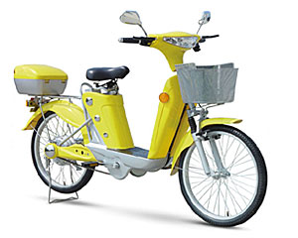
Concept of Operations Electric Bicycle
Concept of operations of the system depends on what the user intends to do with the system
Single person travel (urban areas)
Multiple (2) persons (urban areas)
Small goods delivery (urban areas)
Single person travel (long distance)
Small goods delivery (long distance)

Slide 4
Concept of Operations Type A
Put helmet on.
Release the stand. Hands to hold the handles.
Sit on the bicycle. Feet on ground to support bicycle.
Insert key to bicycle. Turn power on.
Turn right handle forward to increase speed, allow right handle to relax to continue. System limits max. speed 20 kmph (urban limit)
(If more power is required) Press cycling paddle to decelerate.
Turn steering column to turn.
To stop, turn right handle backward to activate regenerative brake.
Wait to stop then put feet on ground to support bicycle.
Turn power off.
Step out of bicycle. Put on stand.

Slide 5
Hierarchy of Functions – Electric Bicycle Type A operation
F0 – To travel around town on two wheels
X
F1 – Heavy duty bicycle
F2 – Bicycle system control
F3 – Battery
F4 – Manual assist clutch
F5 – Goods carrier

Slide 6
FFBD Type A
F3 – Battery
F2 – Bicycle system control
Deliver goods to a destination
Arrive Destination.
AND
AND
F1 – Heavy duty bicycle
F4 – Manual assist clutch
Engage clutch
Torque
Electric bicycle (Level 0 Function)

Slide 7
Hierarchy of Functions – Electric Bicycle Type A operation
4 – Manual assist clutch
4.1 – Pedal set
4.2 – Gear 1
4.3 – Chain
4.4 – Clutch
F4.5 – ear 2

Slide 8
FFBD Function 4 – Manual assist clutch
Force: Foot on paddle
4.1 – Pedal set
4.3 – Chain
Torque1
Torque3
Torque2
4.2 – Gear 1
4.5 – Gear 2
Engage clutch
AND
4.4 – Clutch
Torque
4 – Manual assist clutch

Slide 9
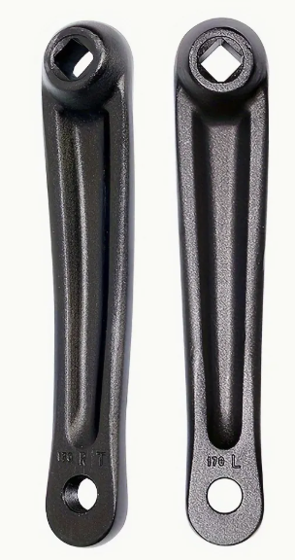
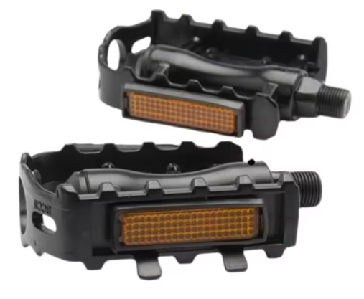
Function 4.1 Pedal set
Force by foot
F
4.1 Pedal set
Torque output from paddle shaft
Actually K₁ = R_{Pedal}

Slide 10
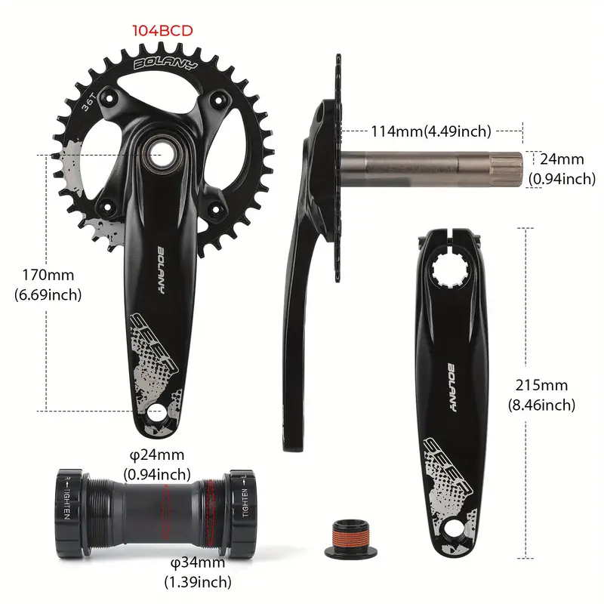
Function 4.2 Gear 1
Torque on Gear 1
4.2 Gear 1
Weight of cable, friction (pulley)

Slide 11
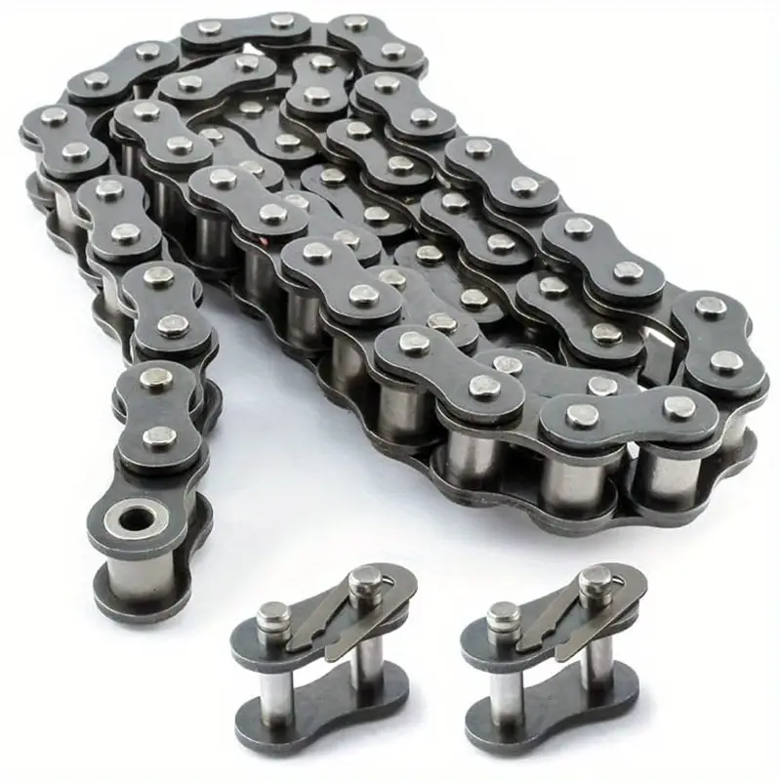
Function 4.3 Chain
Torque from Gear 1
4.3 Chain
Torque from Chain

Slide 12
Function 4.4 Clutch
Engage lock
E
4.4 Clutch
Engaged clutch friction – max torque of the clutch – YES/NO state

Slide 13
Function 4.5 Gear 2
Torque from Chain
4.5 Gear 2
Torque to bicycle wheel shaft

