Slide 1
MIET2565|2566 Systems Engineering Principles Concept of Operations and User Requirements – Tutorial – Electrical bicycle

Slide 2
Insert your name, student number and program
Name
Student number
Program

Slide 3
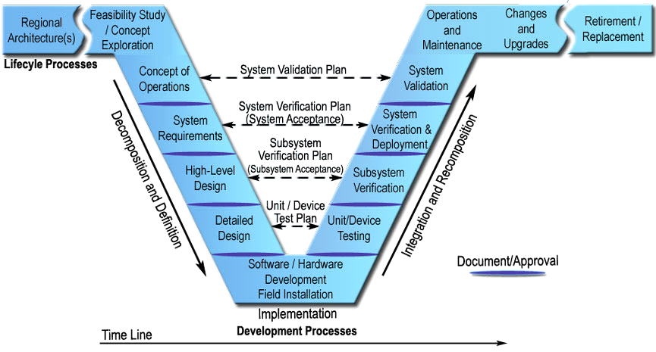
Systems Engineering V Lifecycle Model – International Council on Systems Engineering (INCOSE)

Slide 4
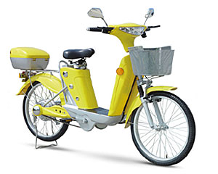
Electric Bicycle

Slide 5
System context
System characteristics | Description | What innovation would make your system design different from others?
Systems are created for specified purposes | A form of low-cost minimum effort transport for short distances (within 50 km radius)
Systems have users | Can be used for 1 or 2 persons to ride-on travel. Goods under 50 kg
Systems interact with the environment around it | To be used in an inner city or urban area. Other traffic on the same road, e.g. cars. Need to watch out all directions during operation. Rural and remote areas may be difficult due to road conditions and long distances.

Slide 6
System context
System characteristics | Description | What innovation would make your system design different from others?
System boundary should be clearly defined | The bike with battery installed. Special charging station (pack) for promised speedy charging. Spare battery. Wiring for all connections. Note: power source is defined as grid power.
Systems are made by integrating components | Components: bike frame, motor, wheels, pedal and chain, controller, steering column, are assembled together. Battery charger is connected to the controller via supplied wire.

Slide 7
System context
System characteristics | Description | What else makes it unique?
Systems are designed by the application of engineering science knowledge | System is stable only when it is running forward (Coriolis effect). No reverse motion. Extra support required when it is not going forward. Induction electric drive system. Constraints are that it can only travel on accessible paths, such as roads and footpaths.

Slide 8
System context
System characteristics | Description | What else makes it unique?
Systems engineering tasks are often not repeating | System is stable only when it is running forward (Coriolis effect). No reverse motion. Extra support required when it is not going forward. Induction electric drive system. Constraints are that it can only travel on accessible paths, such as roads and footpaths.
Systems development and operations are multi-disciplinary | Disciplines: mechanical, electrical, electronics

Slide 9
Concept of operations – 1 person riding
Connect to the bike control. Authenticate to use.
Release the idle support. Hands to hold the handles.
?

Slide 10
Concept of operations – 2 persons riding
Connect to the bike control. Authenticate to use.
Release the idle support. Hands to hold the handles.
?

Slide 11
Concept of operations – Charging
Park bicycle at charging station.
Check charger rating specification.
?

Slide 12
Concept of operations – Carry goods (specify size, quantity, type, etc)
?

Slide 13
User Requirements from concept of operations – Rider authentication
?

Slide 14
User Requirements from concept of operations – Goods balancing
?

Slide 15
User Requirements from concept of operations – (Add your steps)
?

Slide 16
User Requirements from concept of operations – (Add your steps)
?

Slide 17
User Requirements consolidated
?

