Slide 1
MIET2565|2566 Systems Engineering Principles Concept of Operations and User Requirements – Tutorial – Human Jet

Slide 2
Insert your name, student number and program
Name
Student number
Program

Slide 3
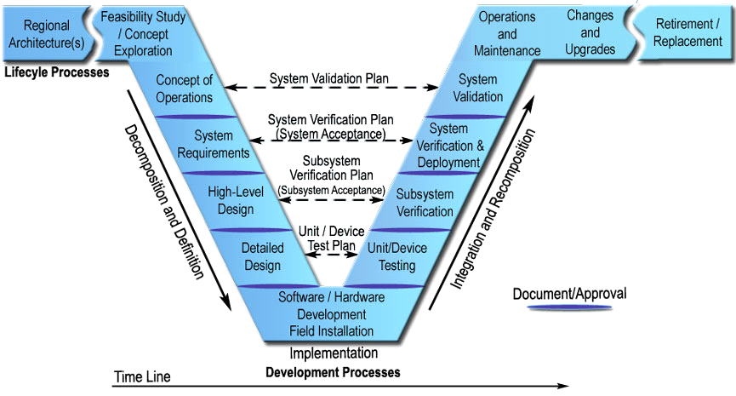
Systems Engineering V Lifecycle Model – International Council on Systems Engineering (INCOSE)

Slide 4
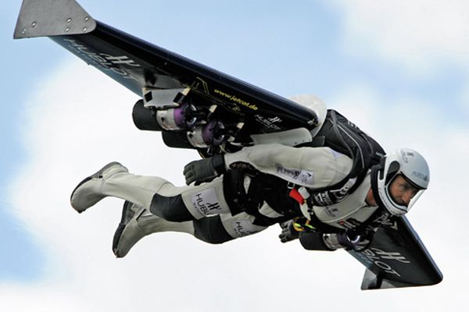
Human Jet

Slide 5
System context
System characteristics | Description | What innovation would make your system design different from others?
Systems are created for specified purposes | Fly at jet speed without in an aircraft Intended as a sport
Systems have users | Single person use. Person will be trained before actual flying.
Systems interact with the environment around it | Flying altitude same as sky dive. All parts of system are exposed to atmosphere. Not for flying over build-up areas. To be guided and monitored by a ground station.

Slide 6
System context
System characteristics | Description | What innovation would make your system design different from others?
System boundary should be clearly defined | All components carried with the person. Communication via defined RF channel.
Systems are made by integrating components | All components are coordinated by the flying person. Person has visibility and control of flying conditions.

Slide 7
System context
System characteristics | Description | What else makes it unique?
Systems are designed by the application of engineering science knowledge | Wing profile and person posture follow aerodynamics design requirements. Engines designed to deliver calculated propulsion

Slide 8
System context
System characteristics | Description | What else makes it unique?
Systems engineering tasks are often not repeating | Every person is different so as the system design for the wing, engine, helmet, etc.
Systems development and operations are multi-disciplinary | Disciplines involved: mechanical, electronics, telecommunication, GIS

Slide 9
Concept of operations – Aircraft launch (Select Method 1 or 2)
This system with the user is mounted under the wing of an aircraft

Slide 10
Concept of operations – Landing by going into an aircraft from the back (Select Method 1 or 2)
Human jet maneuver position in the sky behind an aircraft.

Slide 11
Concept of operations – Stay flying
Read flight information
Decide flight path
?

Slide 12
User Requirements from concept of operations – Launch
?

Slide 13
User Requirements from concept of operations – Land
?

Slide 14
User Requirements from concept of operations – In flight
?

Slide 15
User Requirements from concept of operations – (Add your steps)
?

Slide 16
User Requirements from concept of operations – (Add your steps)
?

Slide 17
User Requirements consolidated
?

Slide 18
Questions?

