Slide 1
MIET2565|2566 Systems Engineering Principles Systems Engineering V Lifecycle, System Requirements – Tutorial – Driverless Car

Slide 2
Insert your name, student number and program
Name
Student number
Program

Slide 3
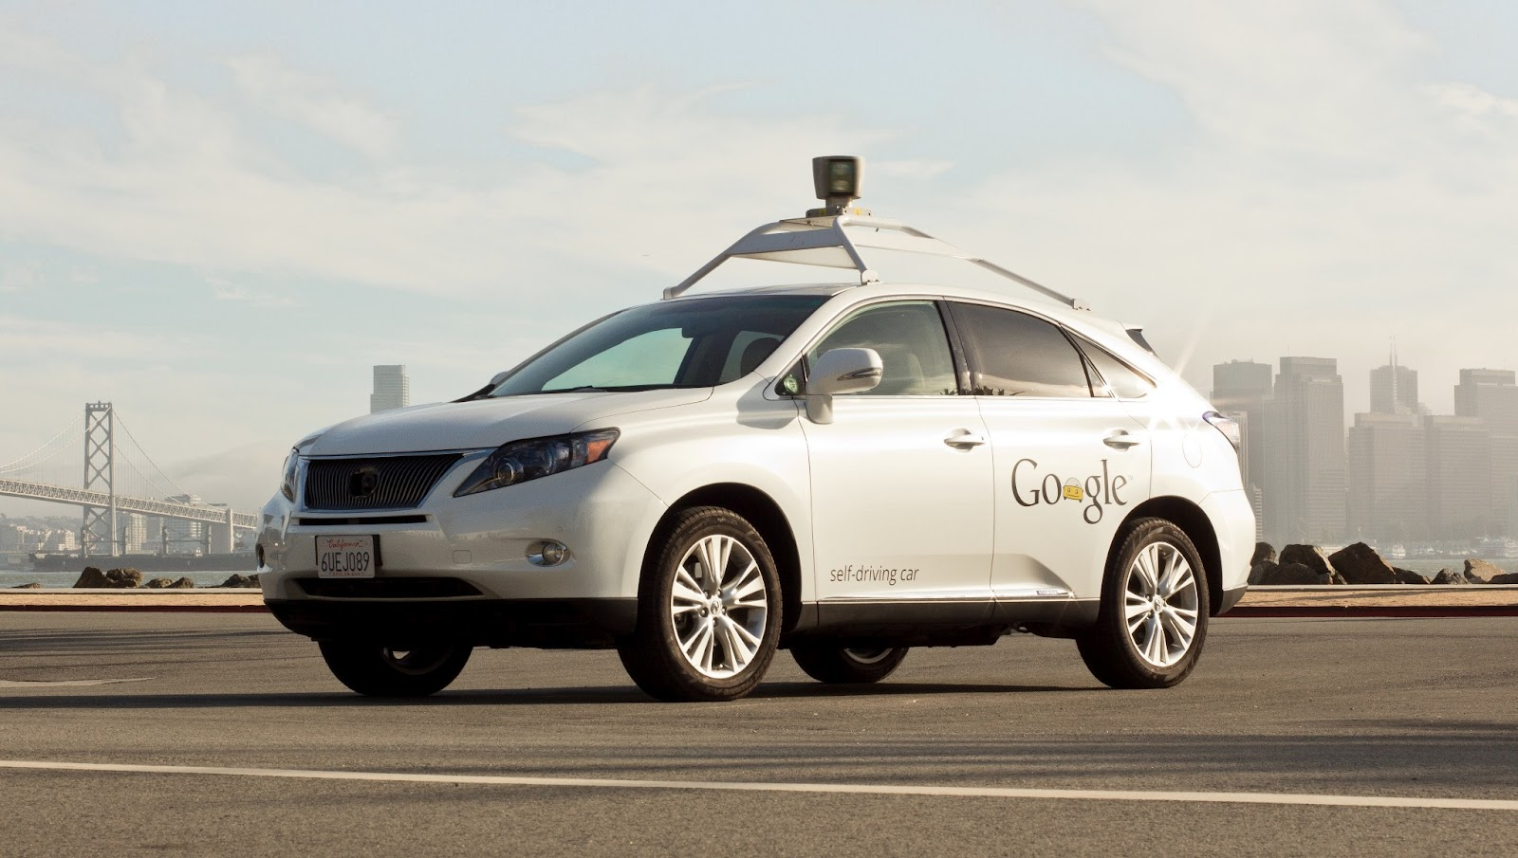
Google Self-driving Car System
https://waymo.com/

Slide 4
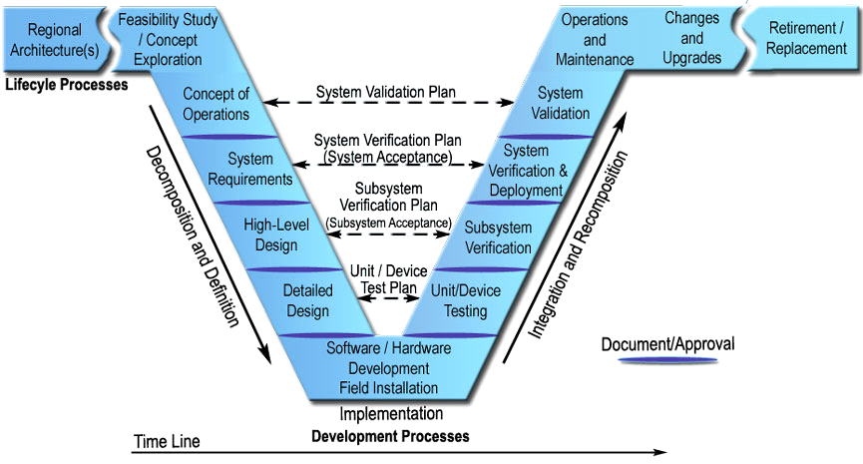
System Requirements
Define User Need
Define System Requirements
System Requirements

Slide 5
User Requirements
System apps downloadable from apps stores to mobile phone by customers.
Customer interacts with central server system with system apps to send all transport information.
Server system computes best car to be deployed. Assigned car can be anywhere on the road or at base station.
Server system can continue to update car deployment information on customer’s apps.
When car arrives, car will have visible signals to customer that this is the car being ordered.
Car can navigate through urban roads to destination.
Car can manage safety requirements for passengers in the car
System manages financial transaction when the job is done.
Car can be modified to be used as van for goods delivery
Car can detect goods at specified location in the car
System advices customer where goods should be loaded and unloaded.

Slide 6
System Requirement 1 to satisfy
UR1 – System apps downloadable from apps stores to mobile phone by customers.
UR2 – Customer interacts with central server system with system apps to send all transport information.
?

Slide 7
System Requirement 2 to satisfy
UR3 – Server system computes best car to be deployed. Assigned car can be anywhere on the road or at base station.
UR4 – Server system can continue to update car deployment information on customer’s apps.
UR8 – System manages financial transaction when the job is done.
UR11 – System advices customer where goods should be loaded and unloaded.
?

Slide 8
System Requirement 3 to satisfy
UR5 – When car arrives, car will have visible signals to customer that this is the car being ordered.
UR6 – Car can navigate through urban roads to destination.
UR7 – Car can manage safety requirements for passengers in the car
?

Slide 9
System Requirement 4 to satisfy
UR9 – Car can be modified to be used as van for goods delivery
UR10 – Car can detect goods at specified location in the car
?

Slide 10
System Requirements consolidated
?

Slide 11
Questions?

