Slide 1
MIET2565|2566 Systems Engineering Principles Systems Engineering V Lifecycle, System Requirements – Tutorial – Human Jet

Slide 2
Insert your name, student number and program
Name
Student number
Program

Slide 3
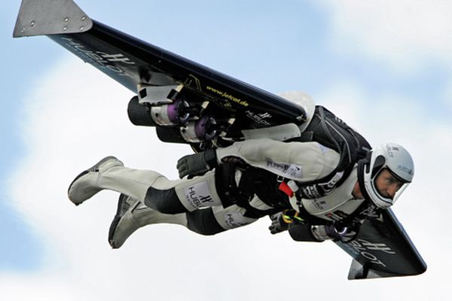
Human Jet

Slide 4
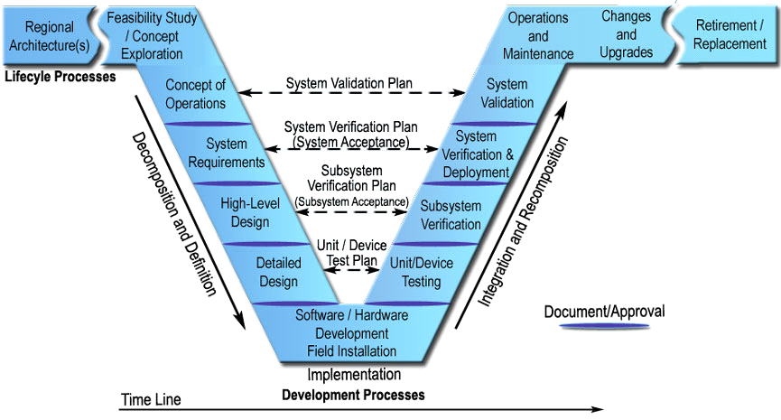
System Requirements
Define User Need
Define System Requirements
System Requirements

Slide 5
User Requirements
System should fit a defined person characteristics – size, weight, sensory, skills
Has anchor points for mounting to carrying aircraft
Able to release in the air while carrying aircraft is flying at required speed
Able to enter a flying cargo aircraft to end the flight
User receives flight information while flying
Altitude, direction, speed
Lifting forces on wings
Engine conditions
Position (relative to land)
Able to change altitude, direction and speed
System provides flight path navigation information
System keeps person warm at 3000 m
User can activate a parachute during emergency
Communicate with ground station

Slide 6
System Requirement 1 to satisfy
UR1 – System should fit a defined person characteristics
UR8 – System keeps person warm at 3000 m
The flying suite has bult in adjustable parameters to suit people of different sizes, weight ranging from 50 kg to 150 kg.
Heat insulation suite. No or minimum exposed body parts to cold air.

Slide 7
System Requirement 1 to satisfy
UR1 – System should fit a defined person characteristics
UR8 – System keeps person warm at 3000 m
?

Slide 8
System Requirement 2 to satisfy
UR5 – User receives flight information while flying
UR7 – System provides flight path navigation information
UR10 – Communicate with ground station
?

Slide 9
System Requirement 3 to satisfy
UR2 – Has anchor points for mounting to carrying aircraft
UR3 – Able to release in the air while carrying aircraft is flying at required speed
?

Slide 10
System Requirement 4 to satisfy
UR4 – Able to enter a flying cargo aircraft to end the flight
?

Slide 11
System Requirement 5 to satisfy
UR6 – Able to change altitude, direction and speed
?

Slide 12
System Requirement 6 to satisfy
UR9 – User can activate a parachute during emergency
?

Slide 13
System Requirements consolidated
?

