Slide 1
MIET2565|2566
Systems Engineering Principles
High Level Design – Tutorial – Driverless Car

Slide 2
Functional Hierarchy
System Function 0
Function 1
Function 2
Function 3
Function 1.1
Function 2.1
Function 3.1
Function 1.2
Function 2.2
Function 3.2
Function 1.3
Function 2.2.1
Function 3.2.1
Function 2.2.2
Function 3.2.2
Function 1.4
Function 2.3
Function 3.2.2.1
Function 1.5
Function 2.3.1
Function 3.2.2.2
Function 1.6
Function 2.3.2
Function 3.2.2.3
Function 2.4

Slide 3
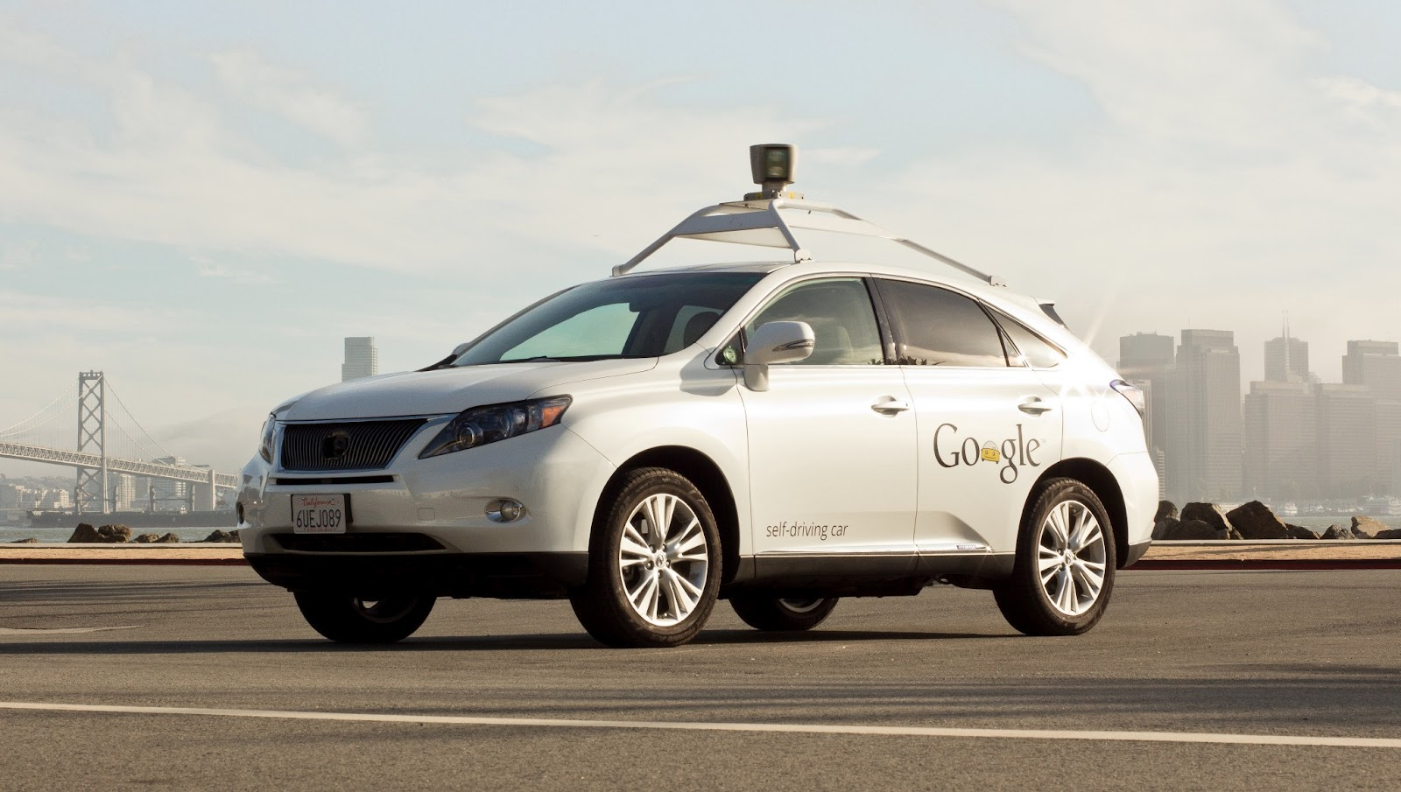
Google Self-driving Car System
https://waymo.com/

Slide 4
Function 0 to transport passengers or goods point-to-point in autonomous vehicles
Passengers order
Passengers at destination
F0 –Autonomous vehicle to transport passengers or goods point-to-point
Goods order
Goods at destination

Slide 5
System Requirements
Driverless car apps to be developed and registered with apps stores
Central server system interacting with multiple apps at any time to receive and check transport order information
Develop internet presence
Server system has software to optimise car deployment and routing
Server system can receive refreshed information from cars in the fleet, including location, loading, state of jobs
Server system has ability to update fleet information dynamically and broadcast
Server system can optimize goods loading according to customer provided goods data such as dimensions and weights.
Server system interacts with major banks and credit card facilities via company account
Server system can update customer goods loading and unloading.
System car has AI to interact with customers “verbally”
Verbal advice includes but not limited to notification of arrival, confirmation of order number, greeting customer, answering order questions, warnings.
Car has self-driving intelligence to follow route advise from server
Car can warn and monitor passengers safety requirements on board

Slide 6
System Requirements
Car body design is adopted from a van configuration.
Seats can be taken off at base station in 5 minutes.
Cameras for monitoring goods loading situation to be installed to car in 10 minutes.
Van transmits goods monitoring camera signals to central server, where recognition goods loading conditions is computed.
Warning for uncomplying goods loading conditions are communicated to the car to notify customers.

Slide 7
Function 1 to meet System Requirement 1 to 9
Driverless car apps to be developed and registered with app stores
Central server system interacting with multiple apps at any time to receive and check transport order information
Develop internet presence
Server system has software to optimise car deployment and routing
Server system can receive refreshed information from cars in the fleet, including location, loading, state of jobs
Server system has ability to update fleet information dynamically and broadcast
Server system can optimize goods loading according to customer provided goods data such as dimensions and weights.
Server system interacts with major banks and credit card facilities via company account
Server system can update customer goods loading and unloading.
?
?
F1 – ?

Slide 8
Function 1 to meet System Requirement 1 to 9
Driverless car apps to be developed and registered with app stores
Central server system interacting with multiple apps at any time to receive and check transport order information
Develop internet presence
Server system has software to optimise car deployment and routing
Server system can receive refreshed information from cars in the fleet, including location, loading, state of jobs
Server system has ability to update fleet information dynamically and broadcast
Server system can optimize goods loading according to customer provided goods data such as dimensions and weights.
Server system interacts with major banks and credit card facilities via company account
Server system can update customer goods loading and unloading.
?

Slide 9
Function 1 to meet System Requirement 1 to 9
Driverless car apps to be developed and registered with apps stores
Central server system interacting with multiple apps at any time to receive and check transport order information
Develop internet presence
Server system has software to optimise car deployment and routing
Server system can receive refreshed information from cars in the fleet, including location, loading, state of jobs
Server system has ability to update fleet information dynamically and broadcast
Server system can optimize goods loading according to customer provided goods data such as dimensions and weights.
Server system interacts with major banks and credit card facilities via company account
Server system can update customer goods loading and unloading.
F1 – ?
F1.1 – ?
F1.2 – ?
F1.3 – ?

Slide 10
Function 2 to meet System Requirements 10 to 11
System car has AI to interact with customers “verbally”
Verbal advices include but not limited to notification of arrival, confirmation of order number, greeting customer, answering order questions, warnings.
?
?
F2 – ?

Slide 11
Function 2 to meet System Requirements 10 to 11
System car has AI to interact with customers “verbally”
Verbal advices include but not limited to notification of arrival, confirmation of order number, greeting customer, answering order questions, warnings.
For Uber Call type system
?
  ?

Slide 12
Function 3 to meet System Requirements 12 to 13
Car has self-driving intelligence to follow route advise from server
Car can warn and monitor passengers safety requirements on board
?
?
F3 – ?

Slide 13
Function 4 to meet System Requirements 14 to 18
Car body design is adopted from a van configuration.
Seats can be taken off at base station in 5 minutes.
Cameras for monitoring goods loading situation to be installed to car in 10 minutes.
Van transmits goods monitoring camera signals to central server, where recognition goods loading conditions is computed.
Warning for uncomplying goods loading conditions are communicated to the car to notify customers.
?
?
F4 – ?

Slide 14
Function 4 to meet System Requirements 14 to 18
Car body design is adopted from a van configuration.
Seats can be taken off at base station in 5 minutes.
Cameras for monitoring goods loading situation to be installed to car in 10 minutes.
Van transmits goods monitoring camera signals to central server, where recognition goods loading conditions is computed.
Warning for uncomplying goods loading conditions are communicated to the car to notify customers.
For Goods Transport type system
?
  ?

Slide 15
Function 4 to meet System Requirements 14 to 18
Car body design is adopted from a van configuration.
Seats can be taken off at base station in 5 minutes.
Cameras for monitoring goods loading situation to be installed to car in 10 minutes.
Van transmits goods monitoring camera signals to central server, where recognition goods loading conditions is computed.
Warning for uncomplying goods loading conditions are communicated to the car to notify customers.
F4 – ?
F4.1 – ?
F4.2 – ?

Slide 16
Hierarchy of Functions – Driverless car/van
F0 – To transport people or goods without on-board personnel
F1 – ?
F2 – ?
F3 – ?
F4 – ?

Slide 17
Hierarchy of Functions – Driverless car/van
F0 – To transport people or goods without on-board personnel
F1 – ?
F2 – ?
F3 – ?
F4 – ?
F1.1 – ?
F1.2 – ?
F1.3 – ?
F4.1 – ?
F4.2 – ?

