Slide 1
MIET2565|2566
Systems Engineering Principles
Functional Flow – Tutorials – Electric Bike

Slide 2
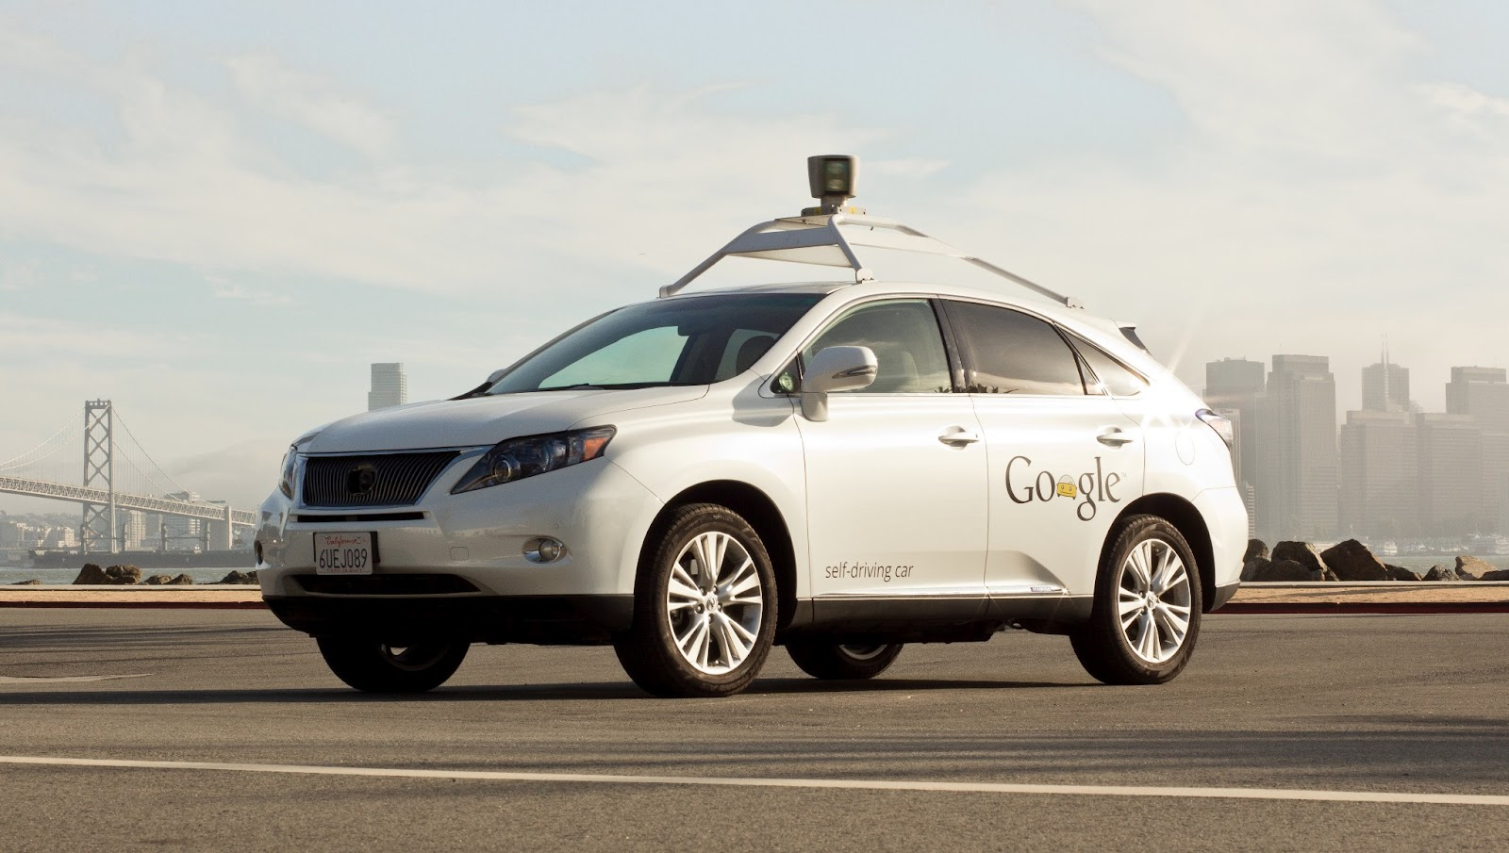
Google Self-driving Car System
https://waymo.com/

Slide 3
Hierarchy of Functions – Driverless car
F0 – To transport people or goods without on-board personnel
F1 – Server and Apps
F2 – In-car customer interaction
F3 – Self driving car
F4 – In-van customer interaction
F5 – Self driving van

Slide 4
How do functions work in the Driverless Car system?
F2 – In-car customer interaction
F1 – Server and Apps
Customer initiated call/order
Arrive destination
F3 – Self driving car
F4 – In-van customer interaction
F5 – Self-driving van
Driverless Car (Level 0 Function)

