Slide 1
MIET2565|2566
Systems Engineering Principles
Functional Flow – Tutorials – Electric Bike

Slide 2
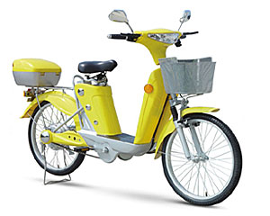
Human Jet

Slide 3
Hierarchy of Functions – Electric Bike (Function 0)
F0 – To travel around town on two wheels
F1 – Heavy duty bicycle
F2 – Bicycle system control
F3 – Battery
F4 – Manual assist clutch
F5 – Goods carrier

Slide 4
How do functions work in the electric bicycle system?
F1 – Heavy duty bicycle
F2 – Bicycle system control
F5 – Goods carrier
Rider at start
Arrive destination
F3 – Battery
Destination information
F4 – Manual assist clutch
Electric bicycle (Level 0 Function)

