Slide 1
MIET2565|2566
Systems Engineering Principles
Functional Flow – Tutorials – Human Jet

Slide 2
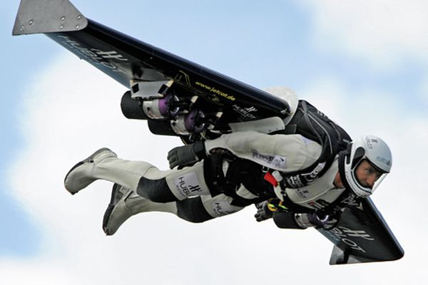
Human Jet

Slide 3
Functional Hierarchy – Human Jet (Function 0)
F0 – Human Jet
F1 – Personal Protection
F2 – Flight control
F3 – Frame (wing and anchor)
F4 – Release mechanism
F5 – Winch to cargo aircraft
F6 – Emergency

Slide 4
How do functions work in the human jet system?
F4 – Release mechanism
F5 – Winch
F3 – Frame
Arrive destination
Fly to a destination
F2 – Flight control
F1 – Personal Protection
F6 – Emergency
Human Jet (Level 0 Function)
OR

