Slide 1
MIET2385
Systems Engineering Principles
Systems Engineering V Lifecycle – High Level Design – Functional Analysis – Tutorial – Driverless Car
Professor John Mo
Building 251, Level 2, Room 27
Email: john.mo@rmit.edu.au

Slide 2
Function Re-use, Re-cycle, Re-generate
An important objective of functional analysis is to consider strategically, whether functions in the system can be re-used due to variations in the system design, compatibility, component availability.
Variations in system application are best handled with re-use, re-cycle, re-generate from a template model.

Slide 3
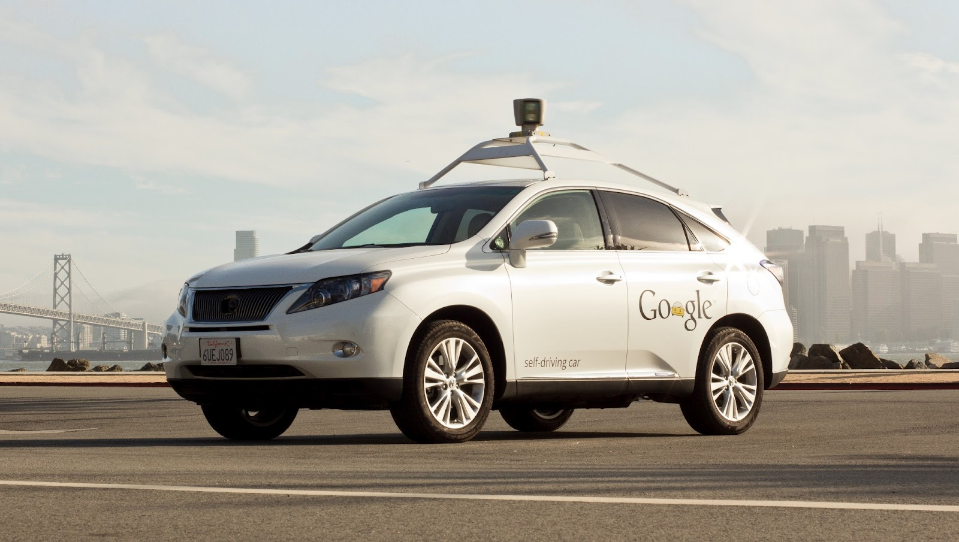
Google Self-driving Car System
https://waymo.com/

Slide 4
Concept of Operations Electric Bicycle
Concept of operations of the system depends on what the user intends to do with the system
Uber style passenger service system
Goods transport service system

Slide 5
Concept of Operations Type A
On a phone Apps, user enters desired destination and number of people, press submit.
The phone Apps sends entered information and user location data to a central server.
The central server commands one driverless passenger car (probably nearest) to the user’s location. The driverless car locates the user’s phone location and stops in front of the user.
User opens the car door and sits in. Multiple users act similarly.
Driverless car explains some rules, waits for all passengers to have seat belts tied up.
Driverless car starts journey. Users are free to do anything so long as seat belt is kept tied up and not disturbing car movements.
Users can interrogate anything with Driverless car, including interesting topic conversation.
Driverless car arrives destination and stops at side of road. Users get off.
Driverless car detects all passengers are off, then notifies user that fees are deducted from user’s registered account.
User’s phone receives journey complete confirmation.

Slide 6
Hierarchy of Functions – Driverless Car System
F0 – To transport people without on-board personnel
F1 – Server and Apps
F2 – In-car customer interaction
(AI conversational)
F3 – Self driving car
F4 – In-van customer interaction (User Apps interactive instructions)
F5 – Self driving van

Slide 7
Type A System FFBD
Passenger in car
Response to passengers
F2 – In-car customer interaction
Order completed
Arrive destination. Customer alighted
Customer initiated call/order
F1 – Server and Apps
F3 – Self driving car
Uber style call
  Customer bank account debited
F4 – In-van customer interaction
F5 – Self-driving van
Driverless Car (Level 0 Function)

Slide 8
Concept of Operations Type B
On a phone Apps, user enters desired destination and number of standard goods boxes, press submit.
The phone Apps sends entered information and user location data to a central server.
The central server commands one driverless van (optimized with routes and capacity) to the user’s location. The driverless van locates the user’s phone location and stops in front of the user.
User opens the van door (side and back) and loads with goods boxes according to loading plan on user’s Apps and guided by an in-van pointing facility.
User secures goods boxes with belts on van. Van confirms secured with LED notice.
User closes all doors, steps away.
Driverless van starts journey to next destination.
Driverless van arrives next destination (assume delivery location) and stops at side of road. User opens the van door (side and back), releases belts and unloads goods according to user’s Apps and guided by an in-van poniting facility.
After all relevant goods unloaded, user closes all doors and steps away.
Driverless van starts journey to next destination.
User’s phone receives message confirming delivery complete and fees deducted from user’s registered account.

Slide 9
Hierarchy of Functions – Driverless Car System
F0 – To transport people without on-board personnel
F1 – Server and Apps
F2 – In-car customer interaction
(AI conversational)
F3 – Self driving car
F4 – In-van customer interaction (User Apps interactive instructions)
F5 – Self driving van

Slide 10
Type B System FFBD
F3 – Self driving car
  Customer bank account debited
Customer initiated call/order
F1 – Server and Apps
Uber style call for goods delivery
F5 – Self-driving van
Order completed
F2 – In-car customer interaction
Arrive destination. Goods picked by customer
F4 – In-van customer direction
Van at stop locations
Direction to customer (loading or picking)
Driverless Car (Level 0 Function)

Slide 11
Hierarchy of Functions – Driverless car/van
F0 – To transport people or goods without on-board personnel
F1 – Server and Apps
F2 – In-car customer interaction
F3 – Self driving car
F4 – In-van customer interaction
F5 – Self driving van
F1.1 – Server
F1.2 – Apps
F1.3 – Communication
F4.1 – AI vision
F4.2 – Communication with customer

Slide 12
F1 – Server and Apps FFBD
?
F1.1 – Server
?
?
F1.2 – Apps
F1.3 – Communication
?
?
?
Server and Apps (Level 1 Function)

Slide 13
F4 – In-van customer interaction FFBD
?
F4.1 – Vision
?
?
F4.2 – Communication with customer
?
?
In-van customer interaction (Level 1 Function)

Slide 14
Questions?

