Slide 1
MIET2385
Systems Engineering Principles
Systems Engineering V Lifecycle – Model Based Systems Engineering – Tutorial – Driverless Car

Slide 2
Insert your name, student number and program BEFORE submitting to CANVAS
Name
Student number
Program

Slide 3
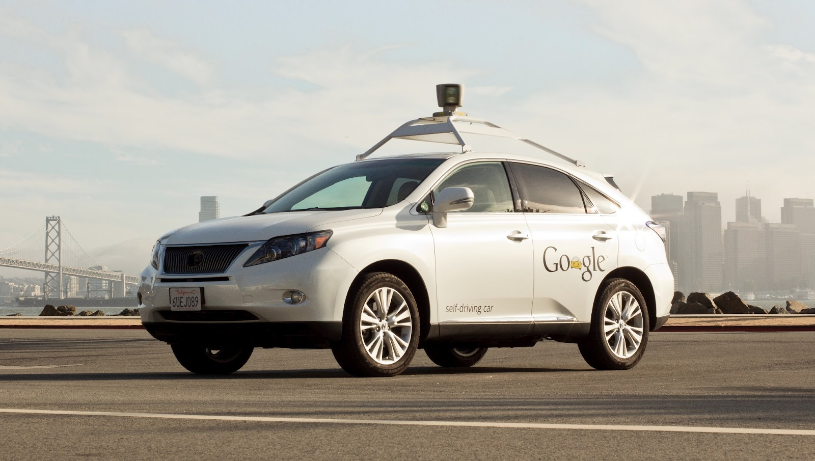
Google Self-driving Car System
https://waymo.com/

Slide 4
Actors
Use Capella to create Actor model
You can capture screendump of your Capella Actor diagram

Slide 5
Functions
Use Capella to create Function model
You can capture screendump of your Capella Function diagram

Slide 6
Sequence
Use Capella to create Sequence model
You can capture screendump of your Capella Sequence diagram

Slide 7
Questions?

