Slide 1
MIET2385 Systems Engineering Principles Systems Engineering V Lifecycle – Detail Design – Tutorial –Human Jet

Slide 2
Insert your name, student number and program BEFORE submitting to CANVAS
Name
Student number
Program

Slide 3
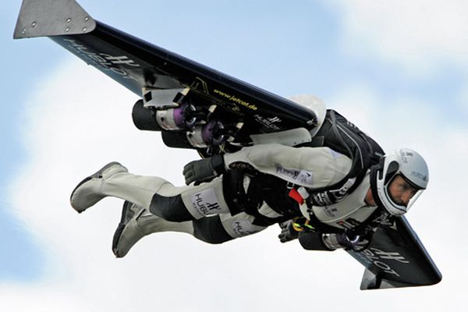
Concept of operations – Type A
Launch 1a – Release from under-wing of a fixed wing aircraft
Fly – Control engine, wing flap, body angle to steer
Land 2c – Fly into an aircraft’s back
Good for mission:
Leisure
Competition
Quick travel – no check-in, no or minimum luggage
Secret mission – undetectable at night and by radar (too small)

Slide 4
Concept of Operations Human Jet Type A
Plan journey via GPS
Check the weather forecast, wind direction
Do jet system diagnostics
Check parachute
Fill with relevant fuel.
Put on safety suit
Tighten and secure jetpack.
Put Helmet on
Hang to under-wing release mechanism of launching aircraft.
Launching aircraft takes off to specified altitude.
Engine starts up.
User controls the throttle and steering at idle speed
Release from under-wing of launching aircraft at flying posture.
User increases the throttle to create thrust and control flying.
At time for landing, user synchronizes speed with cargo aircraft.
Users grabs winch cable.
Staff in cargo aircraft starts rewinding winch.
Human jet enters cargo aircraft cabin.
Remove jetpack

Slide 5
Functional Hierarchy – Human Jet Type A (Function 0)
0 – Human Jet
1 – Personal Protection
2 – Flight control
3 – Frame (wing and anchor)
4 – Release mechanism
5 – Winch to cargo aircraft
6 – Emergency

Slide 6
Type A System FFBD
Human jet ready to hang
Arrive destination
4 – Release mechanism
Human jet released
5 – Winch
3 – Frame
Human jet in cargo aircraft
Human jet flying
Fly to a destination
1 – Personal Protection
OR
2 – Flight control
Human jet ready to fly
Mission fails
6 – Emergency
Human jet emergency landing
Human Jet (Level 0 Function)

Slide 7
Functional Hierarchy – Human Jet Type A (Function 0)
0 – Human Jet
1 – Personal Protection
2 – Flight control
3 – Frame (wing and anchor)
4 – Release mechanism
5 – Winch to cargo aircraft
6 – Emergency

Slide 8
System Requirements for Function 5
Aircraft for human jet returning is modified from a cargo aircraft – empty cabin, back door opening, winching mechanisms, safety belt, etc.
Back door opening width minimum 3 m.
Winching cable length 100 m.
Winching cable end has hooks for human jet system
Winch speed variable from 0 to 10 m per minute.
Winch is powerful enough to lift 150 kg
Cabled Hooks should be stable while hanging in the air – maximum allowable swing 0.2 m circle.
Hook size 0.5 m diameter
All system requirements related to the function must be catered for in Detail Design stage.

Slide 9
Functional Hierarchy – Winch Mechanism
5 – Winch Mechanism
5.1 – Cable
5.2 – Reel
5.3 – Motor
5.4 – Hook
5.5 – Switch box
5.6 – Swing control

Slide 10
Winch Mechanism FFBD
Aircraft crew input
5.5 – Switch box
Power
Power to motor
Force: cable onto reel
5.1 – Cable
5.2 – Reel
AND
Force: Human jet holding hook
Torque: cable force and reel size
Human jet in cargo aircraft
5.3 – Motor
Force: cable direction
Human jet hand trying to hold hook
5.6 – Swing control
Counter swing motions
5.4 – Hook
5 – Winch Mechanism

Slide 11
Function 5.4 Hook (Input and output defined)
Weight of flyer
Force: Human jet holding hook
5.4 Hook
What form of hook, ladder, ring?
How big is it?
What forces does it handle?
What materials?
Make or buy (where and what to buy)?

Slide 12
Function 5.1 Cable (Input and output defined)
Forces: Human jet plus hook
Forces in the cable
5.1 Cable
Cable size (diameter), length?
What material?
How flexible?
What materials?
Make or buy (where and what to buy)?

Slide 13
Function 5.2 Reel (Input and output defined)
Force from cable
Torque on reel
5.2 Reel
How big is the reel? (Also depends on cable length)
What torque is required for the reel? (Depends on diameter)
What material?
Fixture?
Shape, dimensions, features?
Make or buy (where and what to buy)?

Slide 14
Function 5.3 Motor (Input and output defined)
Torque on reel
Speed of motor on winch
5.3 Motor
Size (and power) of motor?
Speed of motor?
Torque required on motor?
This is normally a procured component. Where to buy?

Slide 15
Function 5.6 Swing control (Input and output defined)
Counter swing motion
Direction of cable
5.6 Swing control
What type of swing to be controlled? Define stability required?
How does direction of cable detected or measured?
What counter swing motion is required?
How does this mechanism counteract the swing?
How does this swing control mechanism look like?
Is it available commercially? Make or buy?
Is it programmable? If yes, how to program it?

Slide 16
Hierarchy of Functions – Human Jet Type A (Function 1)
0. Human jet
1 – Personal Protection
2 – Flight control
3 – Frame (wing and anchor)
4 – Release mechanism
5 – Winch to cargo aircraft
6 – Emergency
How big is the hook?
What materials?
Make or buy (where and what to buy)?
1.1 Suit
1.2 Helmet
1.3 Harness
1.4 Boot

Slide 17
Function 1.1 Suit
What size, shape, design?
What materials?
What features? Harness location?

Slide 18
Function 1.2 Helmet
What size, shape, design?
What materials?
Impact to resist?
What features? Screen?
Power required?

Slide 19
Function 1.3 Harness
What size, shape, design?
What materials?
What features?
Make or buy?
If make, where to buy materials, who to make it, design information?

Slide 20
Function 1.4 Boot
What size, shape, design?
What materials?
What features? Keep warm?

Slide 21
Hierarchy of Functions – Human Jet Type A (Function 3)
0. Human jet
1 – Personal Protection
2 – Flight control
3 – Frame (wing and anchor)
4 – Release mechanism
5 – Winch to cargo aircraft
6 – Emergency
3.1 Honeycomb profile
3.2 Impregnated films (surface)
3.3 Hook for engine
3.4 Hook for harness

Slide 22
Function 3.1 Honeycomb profile
What strength?
What materials?
Where to get materials supply?

Slide 23
Function 3.2 Impregnated films
What strength?
What materials?
Where to get materials supply?

Slide 24
Function 3.3 Hook for engine
What size, shape, anchoring points, design?
What materials?
Make or buy?

Slide 25
Function 3.4 Hook for harness
What size, shape, anchoring points, design?
What materials?
Make or buy?

