Slide 1
MIET2385 Systems Engineering Principles Systems Engineering V Lifecycle – Detail Design – Tutorial – Driverless Car

Slide 2
Insert your name, student number and program BEFORE submitting to CANVAS
Name
Student number
Program

Slide 3
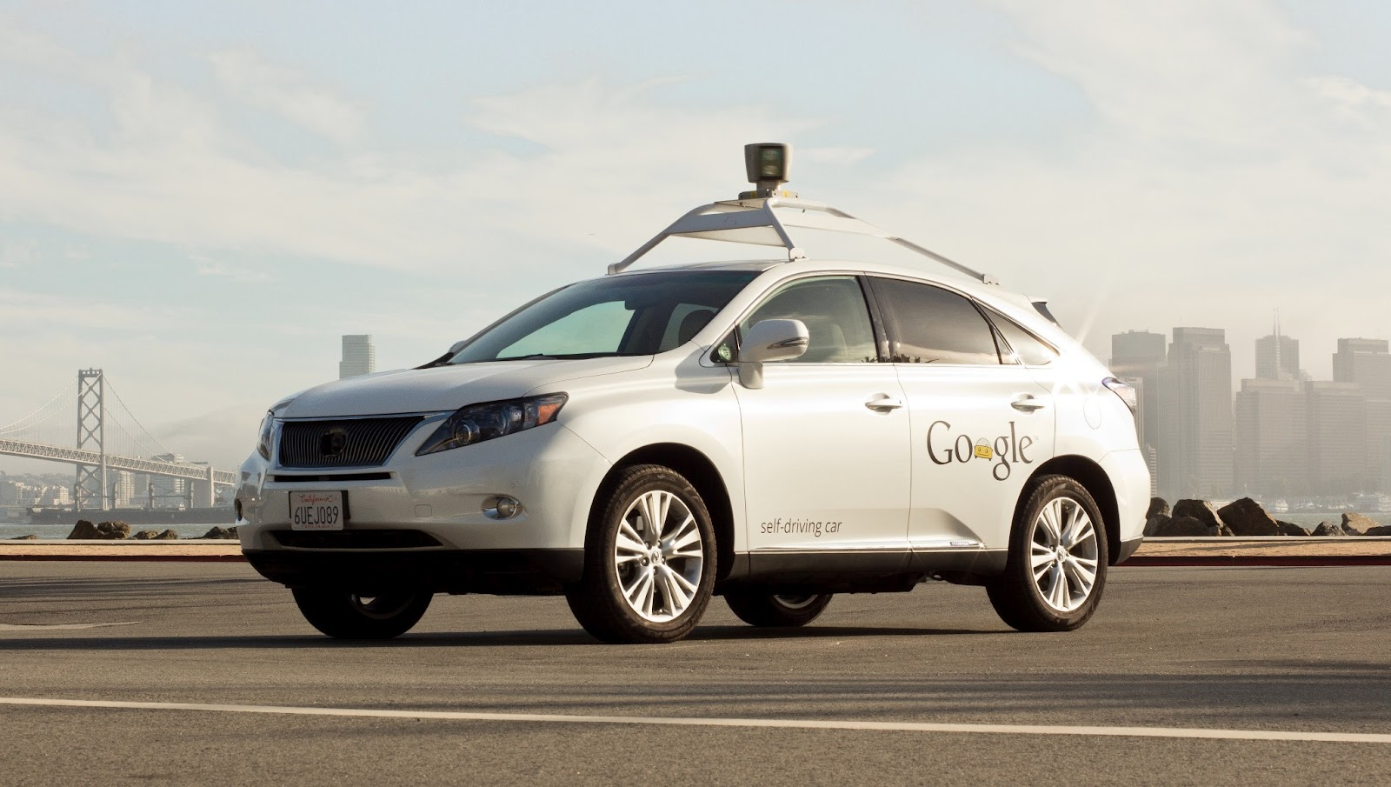
Google Self-driving Car System
https://waymo.com/

Slide 4
Concept of Operations Electric Bicycle
Concept of operations of the system depends on what the user intends to do with the system
Uber style passenger service system
Goods transport service system

Slide 5
Concept of Operations Type B
On a phone Apps, user enters desired destination and number of standard goods boxes, press submit.
The phone Apps sends entered information and user location data to a central server.
The central server commands one driverless van (optimized with routes and capacity) to the user’s location. The driverless van locates the user’s phone location and stops in front of the user.
User opens the van door (side and back) and loads with goods boxes according to loading plan on user’s Apps.
User secures goods boxes with belts on van. Van confirms secured with LEDs.
User closes all doors, steps away.
Driverless van starts journey to next destination.
Driverless van arrives next destination (assume delivery location) and stops at side of road. User opens the van door (side and back), releases belts and unloads goods according to user’s Apps.
After all relevant goods unloaded, user closes all doors and steps away.
Driverless van starts journey to next destination.
User’s phone receives message confirming delivery complete and fees deducted from user’s registered account.
.

Slide 6
Hierarchy of Functions – Driverless Car Type B operation
F0 – To transport people without on-board personnel
F2 – In-car customer interaction
(AI conversational)
X
F1 – Server and Apps
X
F3 – Self driving car
F4 – In-van customer interaction (User Apps interactive instructions)
F5 – Self driving van

Slide 7
Type B System FFBD
X
F2 – In-car customer interaction
X
Customer initiated call/order
F3 – Self driving car
F1 – Server and Apps
Debit customer bank account
OR
Goods in van
Goods delivery order
F4 – In-van customer interaction
F5 – Self-driving van
Arrive destination. Goods picked up by customer
Order completed
Driverless Car (Level 0 Function)

Slide 8
Hierarchy of Function – F4 – In-van customer interaction (User Apps interactive instructions)
F4 – In-van customer interaction (User Apps interactive instructions)
F4.1 – Server
F4.2 – Van layout allocation algorithm
F4.3 – In-van cameras
F4.4 – Apps to guide customer loading/ unloading

Slide 9
F4 – In-van customer interaction
F4.2 – Van layout allocation algorithm
F4.3 – In-van cameras
Goods delivery order
F4.1 – Server
OR
Goods in van
Goods delivery order
AND
4.4 – Apps to guide customer loading/ unloading
Arrive destination. Goods picked up by customer
Order completed
F4 – In-van customer interaction (User Apps interactive instructions)

Slide 10
Function F4.1 – Server (Input and output defined)
Customer order goods data
4.1 Server
Layout of goods
Available algorithm
What is the server?
What type of computer?
Make or buy?
What is the software/algorithm? Who can develop it?
What platform to run?
Customer order format?
What does layout mean?

Slide 11
Function 4.1 is required to satisfy the following customer provided goods delivery pattern
All customers are requested to pack their goods into standard cartoon boxes of dimension: 0.1m by 0.1m by 0.2m.
One particular van is required to pick up and deliver goods en-route to several customers as shown in the table below:
Design the van: (1) Size in goods chamber, (2) Recommended layout instructions for each customer, (3) Recommended route
Note 1: Customer delivery order can be different from the listed sequence.
Location | Number of boxes in van | Boxes loaded to the van | Boxes taken from the van
Depot | 0 | 0 | 0
Customer 1 | 0 | 20 | 0
Customer 2 | 20 (Note 1) | 5 | 10
Customer 3 | 15 | 25 | 10
Customer 4 |  | 15 | 10
Customer 5 |  | 10 | 30

Slide 12
Function F4.2 – Van layout allocation algorithm (Input and output defined)
Provision of algorithm program
F4.2 – Van layout allocation algorithm
Goods compartment configuration?
To avoid complex handling of boxes at customer locations, explain the algorithm.
What are the rules for laying boxes to the van?
At the first customer’s location, where to put first box?
Where to put second box, third, fourth, etc?
At the next customer’s location, where to put first box? After removing a box on the van?
Provide an example of operations and prove the algorithm works.

Slide 13
Function F4.3 – In-van cameras (Input and output defined)
F4.3 – In-van cameras
Layout for customer
Layout confirmed
Function needs to understand layout information.
Function needs to recognise box locations from video information.
Function is able to compare input layout information to video recognised box layout information
Format of layout confirm?
Camera:
What size, resolution?
What capabilities? Automatic, cycling
Where and how to mount?

Slide 14
Function F4.4 – Apps to guide customer loading/ unloading (Input and output defined)
Goods delivered / picked up
Layout for customer
F4.4 – Apps to guide customer loading/ unloading
Function needs to understand layout information
Function needs to know current box layout status
Function needs to calculate and guide sequence of box placement and retrieval
Format of goods placed / retrieved signal?
Apps:
Where to download?
Platform constraints?

Slide 15
Questions?

