Slide 1
MIET2385 Systems Engineering Principles Systems Engineering V Lifecycle – Detail Design – Tutorial – Electrical bicycle

Slide 2
Insert your name, student number and program BEFORE submitting to CANVAS
Name
Student number
Program

Slide 3
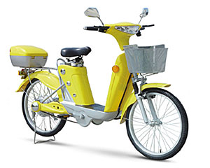
Concept of Operations Electric Bicycle
Concept of operations of the system depends on what the user intends to do with the system
Single person travel (urban areas)
Multiple (2) persons (urban areas)
Small goods delivery (urban areas)
Single person travel (long distance)
Small goods delivery (long distance)

Slide 4
Concept of Operations Type A
Put helmet on.
Release the stand. Hands to hold the handles.
Sit on the bicycle. Feet on ground to support bicycle.
Insert key to bicycle. Turn power on.
Turn right handle forward to increase speed, allow right handle to relax to continue. System limits max. speed 20 kmph (urban limit)
(If more power is required) Press cycling paddle to decelerate.
Turn steering column to turn.
To stop, turn right handle backward to activate regenerative brake.
Wait to stop then put feet on ground to support bicycle.
Turn power off.
Step out of bicycle. Put on stand.

Slide 5
Hierarchy of Functions – Electric Bicycle Type A operation
F0 – To travel around town on two wheels
X
F1 – Heavy duty bicycle
F2 – Bicycle system control
F3 – Battery
F4 – Manual assist clutch
F5 – Goods carrier

Slide 6
FFBD Type A
F3 – Battery
F2 – Bicycle system control
Deliver goods to a destination
Arrive Destination.
AND
AND
F1 – Heavy duty bicycle
F4 – Manual assist clutch
Engage clutch
Torque
Electric bicycle (Level 0 Function)

Slide 7
Hierarchy of Functions – Electric Bicycle Type A operation
4 – Manual assist clutch
4.1 – Pedal set
4.2 – Gear 1
4.3 – Chain
4.4 – Clutch
F4.5 – Gear 2

Slide 8
4.1 – Pedal set
What size, shape, connection?
Make or buy?

Slide 9
4.2 – Gear 1
What size, shape, connection?
Make or buy?

Slide 10
4.3 – Chain
What size, shape, connection?
What sprocket?
Make or buy?

Slide 11
4.4 – Clutch
What size, shape, connection?
What torque?
Make or buy?

Slide 12
4.5 – Gear 2
What size, shape, connection?
Make or buy?

Slide 13
FFBD Function 4 – Manual assist clutch
Force: Foot on paddle
4.1 – Pedal set
4.3 – Chain
Torque1
Torque3
Torque2
4.2 – Gear 1
4.5 – Gear 2
Engage clutch
AND
4.4 – Clutch
Torque
4 – Manual assist clutch

Slide 14
Function 2 – Bicycle system control functional hierarchy Electric Bicycle Type A operation
Signal:
Velocity
2 – Bicycle system control
2.1 –
Mass Range Calculations
2.2 – Motor Load Calculations
2.3 – Gradient Resistance
2.4 – Aerodynamic Resistance
2.5 – Rolling Resistance

Slide 15
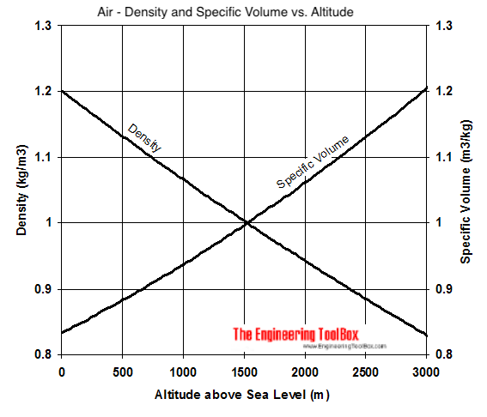
Density of air varies with altitude
h
Note: Other factors may affect this graph, e.g. temperature, moisture content, air pressure. Use this graph as basis for general estimation only.

Slide 16
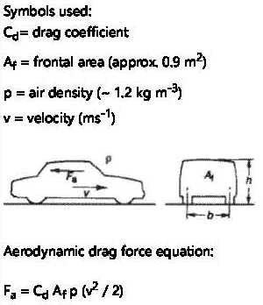
Aerodynamic drag force

Slide 17
Drag Coefficients
Type of Object | Drag Coefficient - c_{d} - | Frontal Area
Bike - Drafting behind an other cyclist | 0.5 | 3.9 ft² (0.36 m²)
Convertible, open top | 0.6 - 0.7 | frontal area
Bus | 0.6 - 0.8 | frontal area
Old Car like a T-ford | 0.7 - 0.9 | frontal area
Cube | 0.8 | s2
Bike - Racing | 0.88 | 3.9 ft² (0.36 m²)
Bicycle | 0.9
Tractor Trailed Truck | 0.96 | frontal area
Truck | 0.8 - 1.0 | frontal area
Person standing | 1.0 – 1.3
Bike - Upright Commuter | 1.1 | 5.5 ft² (0.51 m²)
Thin Disk | 1.1 | π / 4 d2
Solid Hemisphere flow normal to flat side | 1.17 | π / 4 d2
Squared flat plate at 90 deg | 1.17
Wires and cables | 1.0 - 1.3
Person (upright position) | 1.0 - 1.3
Hollow semi-cylinder opposite stream | 1.2
Ski jumper | 1.2 - 1.3
Hollow semi-sphere opposite stream | 1.42
Passenger Train | 1.8 | frontal area
Motorcycle and rider | 1.8 | frontal area
Long flat plate at 90 deg | 1.98
Rectangular box | 2.1
Type of Object | Drag Coefficient - c_{d} - | Frontal Area
Laminar flat plate (Re=106) | 0.001
Dolphin | 0.0036 | wetted area
Turbulent flat plate (Re=106) | 0.005
Subsonic Transport Aircraft | 0.012
Supersonic Fighter,M=2.5 | 0.016
Streamlined body | 0.04 | π / 4 d2
Airplane wing, normal position | 0.05
Sreamlined half-body | 0.09
Long stream-lined body | 0.1
Bicycle - Streamlined Velomobile | 0.12 | 5 ft² (0.47 m²)
Airplane wing, stalled | 0.15
Modern car like a Tesla model 3 or model Y | 0.23
Toyota Prius, Tesla model S | 0.24 | frontal area
Tesla model X
Sports car, sloping rear | 0.2 - 0.3 | frontal area
Common car like Opel Vectra (class C) | 0.29 | frontal area
Hollow semi-sphere facing stream | 0.38
Bird | 0.4 | frontal area
Solid Hemisphere | 0.42 | π / 4 d2
Sphere | 0.5
Saloon Car, stepped rear | 0.4 - 0.5 | frontal area

Slide 18
What is your recommendation for one or more of the 2.x components?
Size and characteristics of motor
Acceleration capability
Component designs, e.g. size, mass, electricity, etc.

